Slide 1
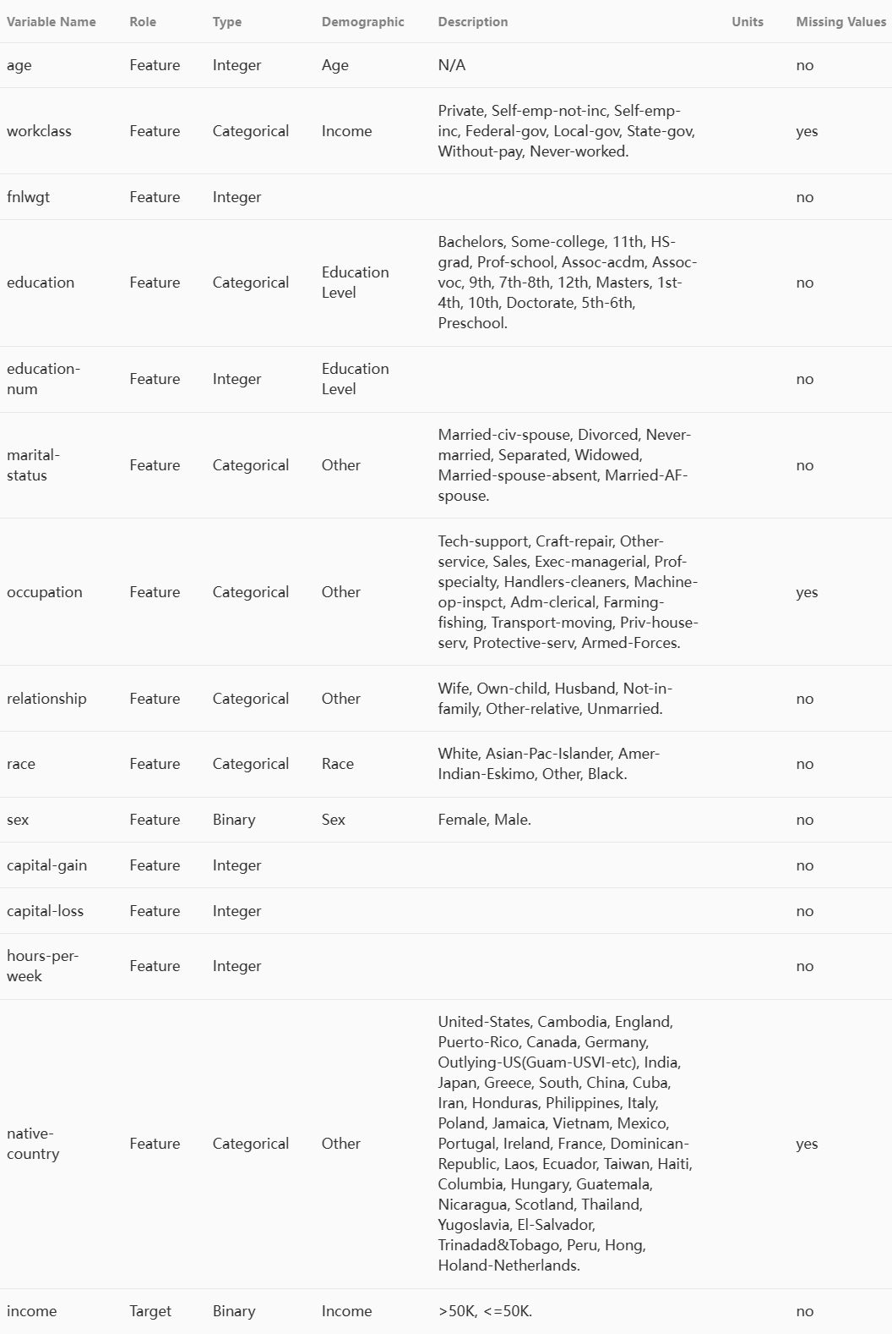
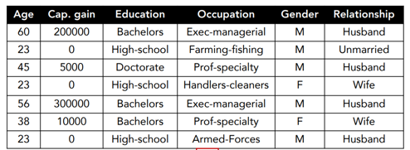

Adult:
Tabular Dataset
数据类型：categorical feature, numerical feature
任务类型：regression, binary classification, multiclass classification
数据集例子：California housing, Adult, Helena

Slide 2
Tabular machine learning
1. Traditional ML models: GBDT
2. Deep Learning Models: MLP, ResNet, Transformer

Slide 3
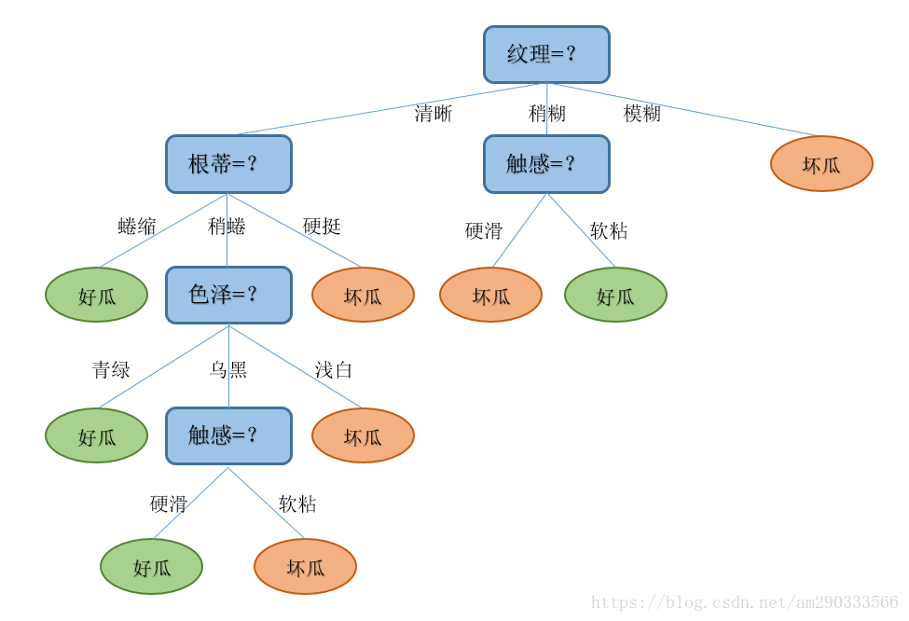
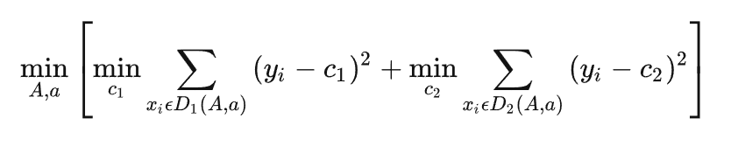
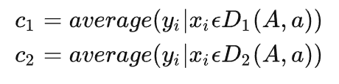
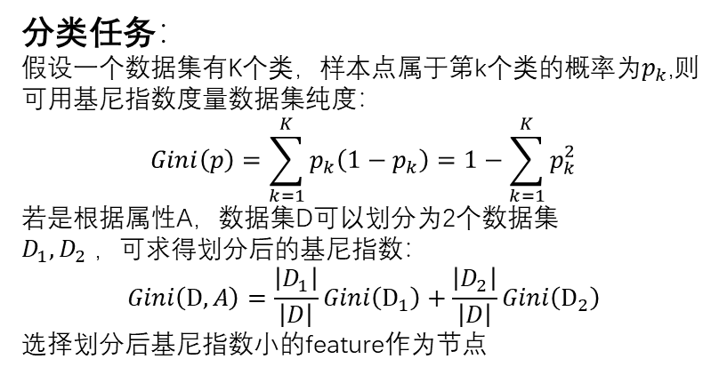
Decision Tree
分类任务：
假设一个数据集有K个类，样本点属于第k个类的概率为$p_{k}$,则可用基尼指数度量数据集纯度：
$$Gini\left(p\right)=\sum_{k=1}^{K}{p_{k}\left(1−p_{k}\right)=1−\sum_{k=1}^{K}{p_{k}^{2}}}$$
若是根据属性A，数据集D可以划分为2个数据集$D_{1},D_{2} ，可求得$划分后的基尼指数：
$$Gini\left(D,A\right)=\frac{\left|D_{1}\right|}{\left|D\right|}Gini\left(D_{1}\right)+\frac{\left|D_{2}\right|}{\left|D\right|}Gini\left(D_{2}\right)$$
选择划分后基尼指数小的feature作为节点
CART, ID3, ID4.5
回归任务：
度量数据集纯度使用误差平方:

Slide 4
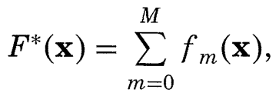
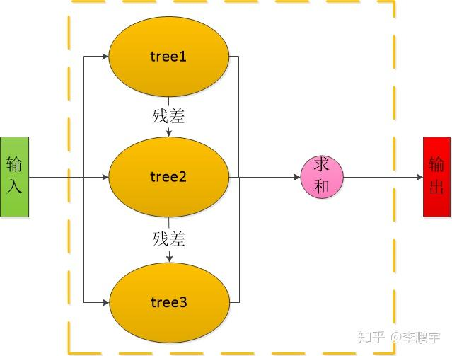
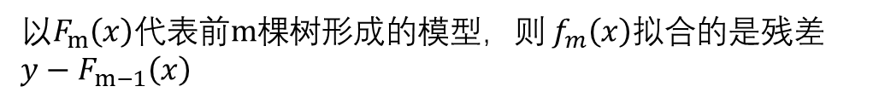
Decision Tree
Boosting Tree
以$f_{m}(x)$代表第m棵树表示的函数，$F^{∗}(x)代表$整个模型函数，则
以$F_{m}\left(x\right)代表前m棵树形成的模型，则 f_{m}\left(x\right)拟合$的是残差$y−F_{m−1}\left(x\right)$

Slide 5
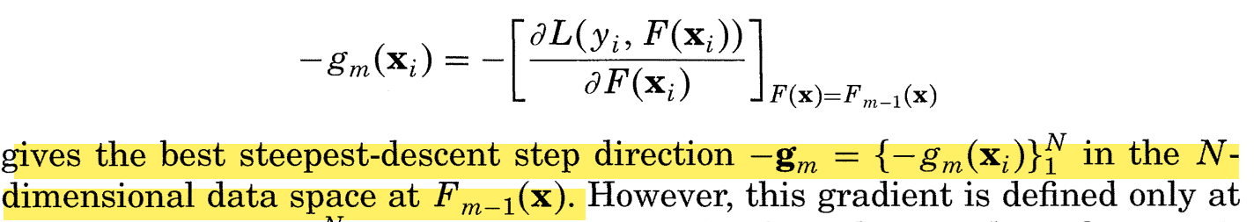
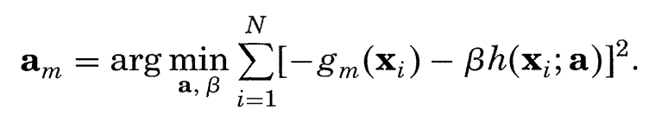
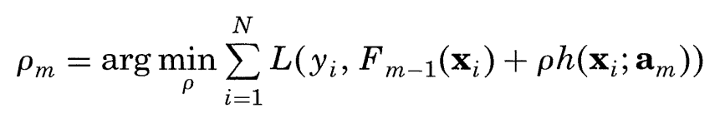
Decision Tree
Gradient Boosting Decision Tree(GBDT)

Slide 6
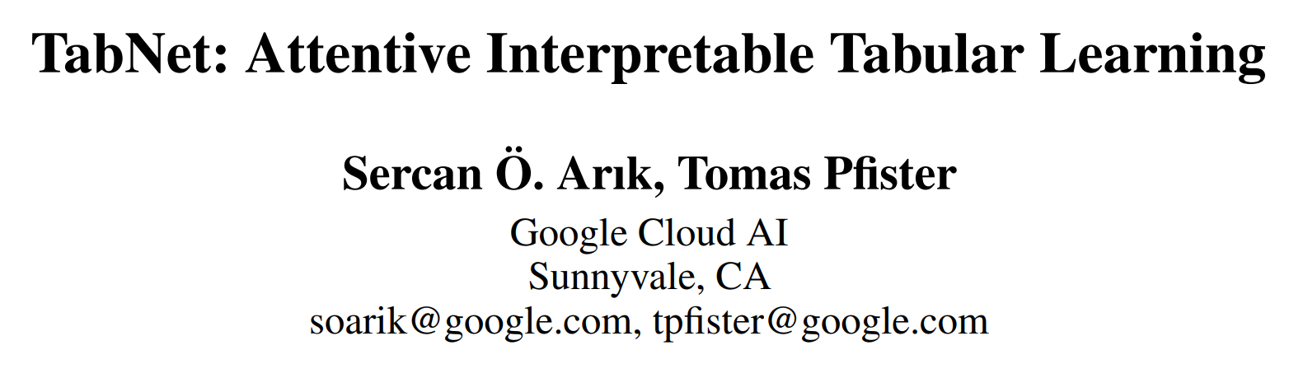
AAAI 2021

Slide 7
Motivation
Benefits of Decision Tree
they are representionally efficient for decision manifolds with approximately hyperplane boundaries which are common in tabular data
they are highly interpretable in their basic form
they are fast to train
Benefits of Neural Network
efficiently encoding multiple data types like images along with tabular data
alleviating the need for feature engineering
learning from streaming data
End-to-end models allow representation learning

Slide 8
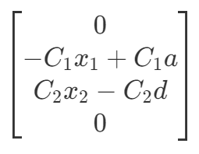
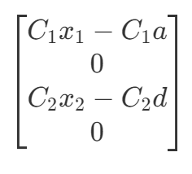
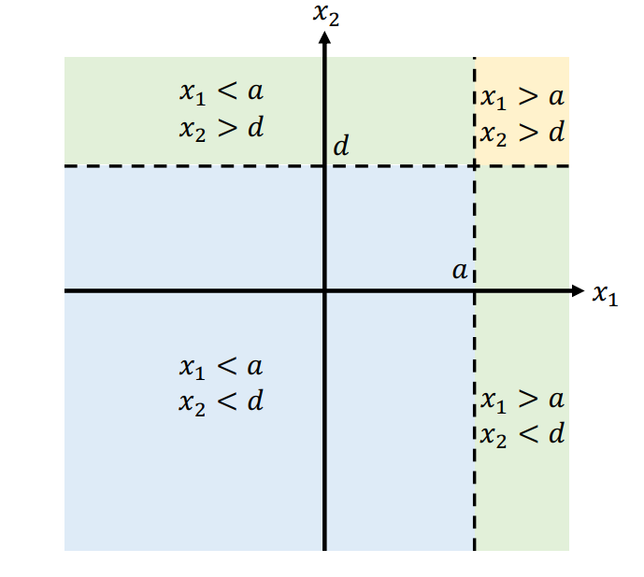
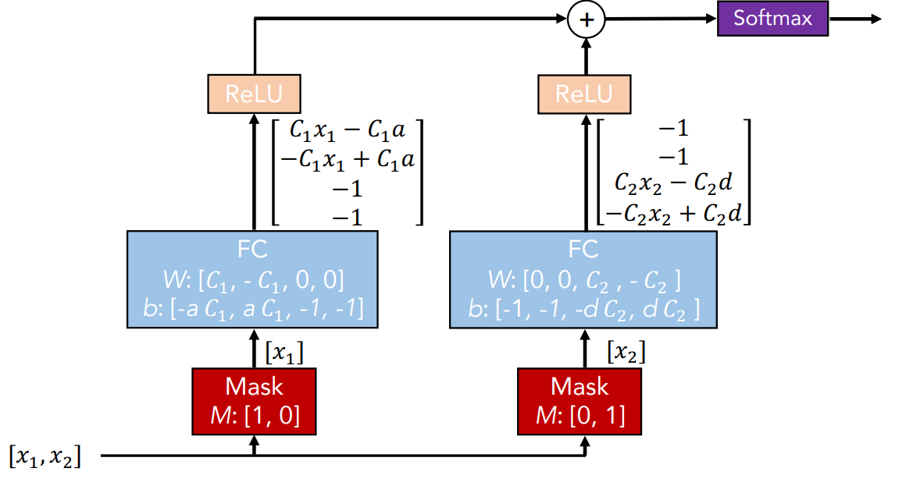
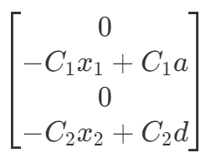
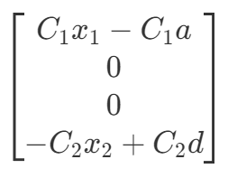
Motivation

Slide 9
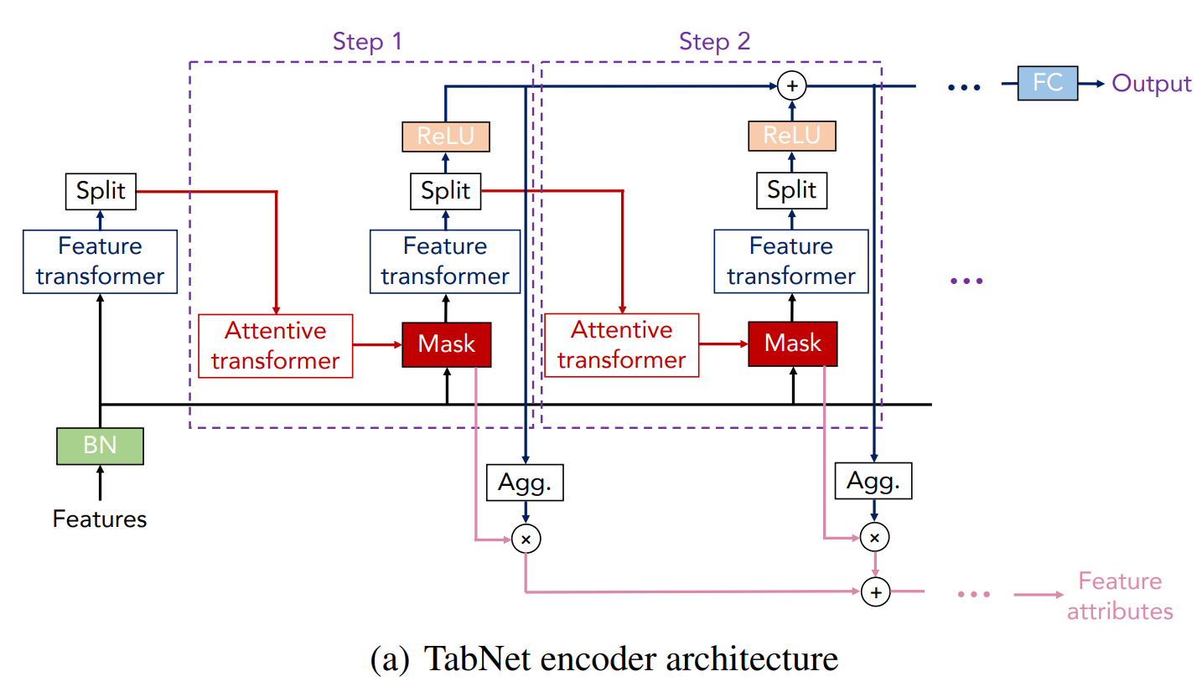
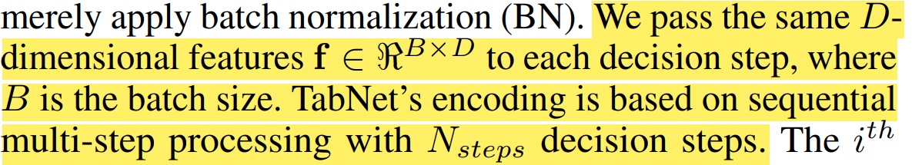
Architecture

Slide 10
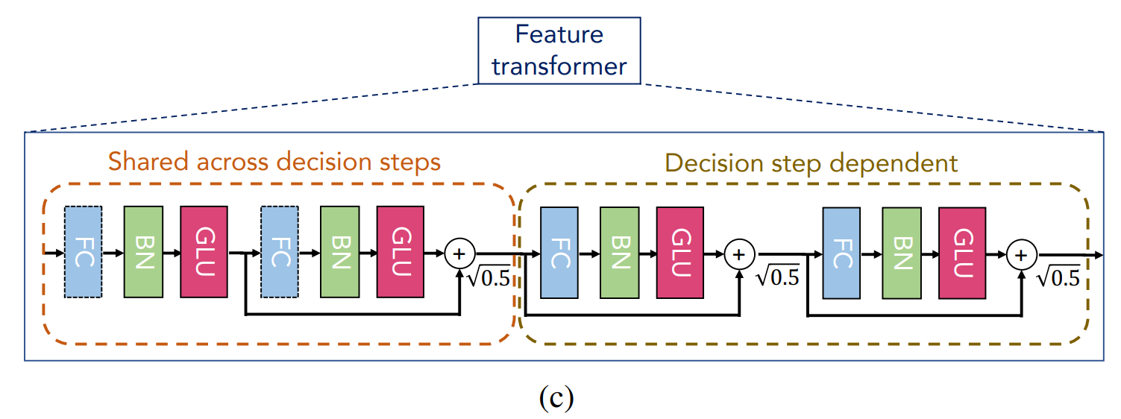
Architecture
Feature transformer: Feature Processing
$$GLU(x)=(XW+b)⨂sigmoid(XV+c)$$

Slide 11
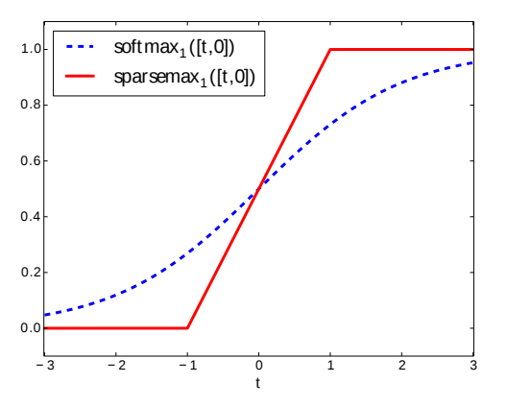
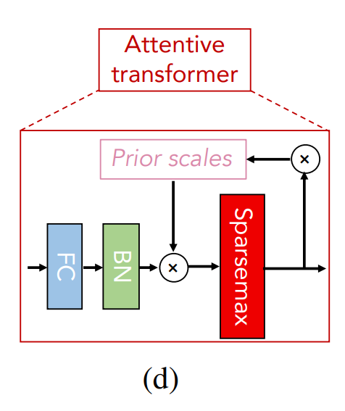
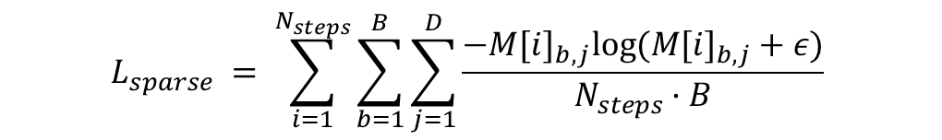
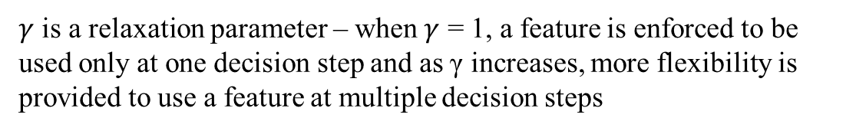

Architecture
Attentive transformer: for feature selection
mask $M\left[i\right]∈ < B×D$ for soft selection of the salient features
$$M[i] = sparsemax(P[i − 1] · hi(a[i − 1]))$$
$$P[i] = \prod_{j=1}^{i}{(γ − M[j])}$$
$γ$ is a relaxation parameter – when $γ$ = 1, a feature is enforced to be used only at one decision step and as γ increases, more flexibility is provided to use a feature at multiple decision steps
$$L_{sparse} = \sum_{i=1}^{N_{steps}}{\sum_{b=1}^{B}{\sum_{j=1}^{D}{\frac{−{M[i]}_{b,j}log⁡({M[i]}_{b,j}+ε)}{N_{steps}·B} }}}$$

Slide 12
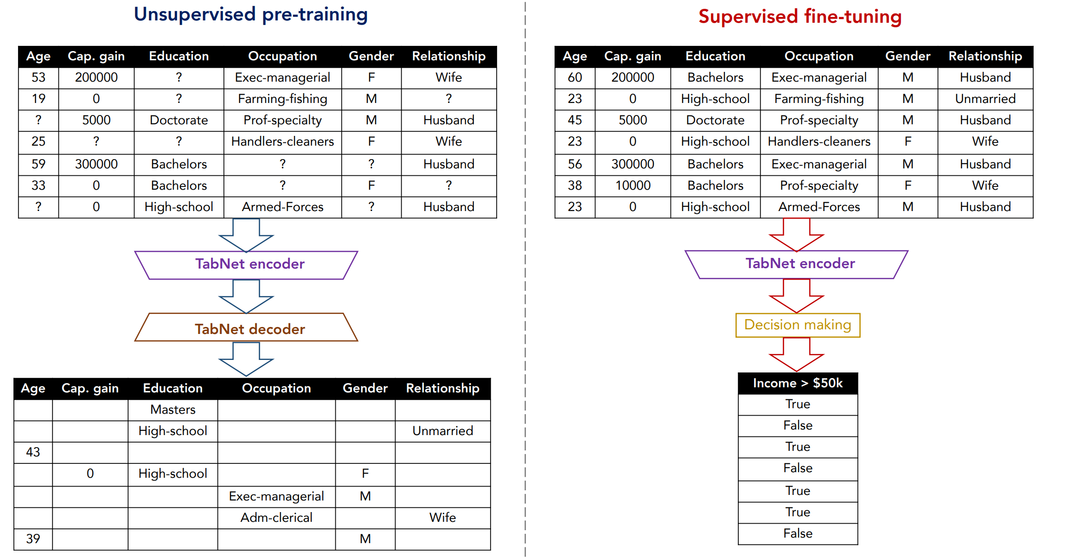
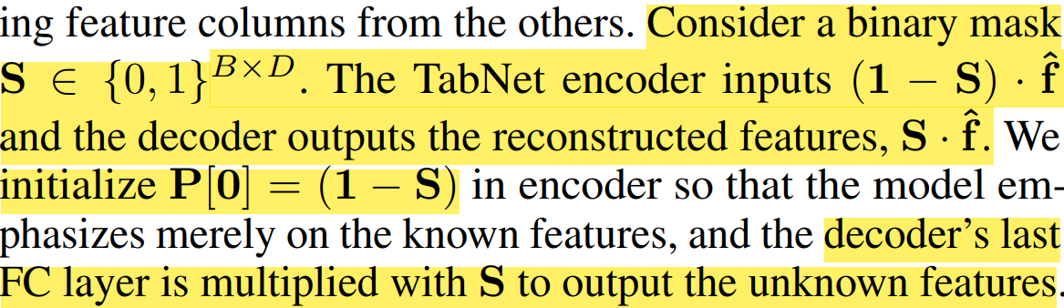
Architecture
Self-Supervised Pretrain

Slide 13
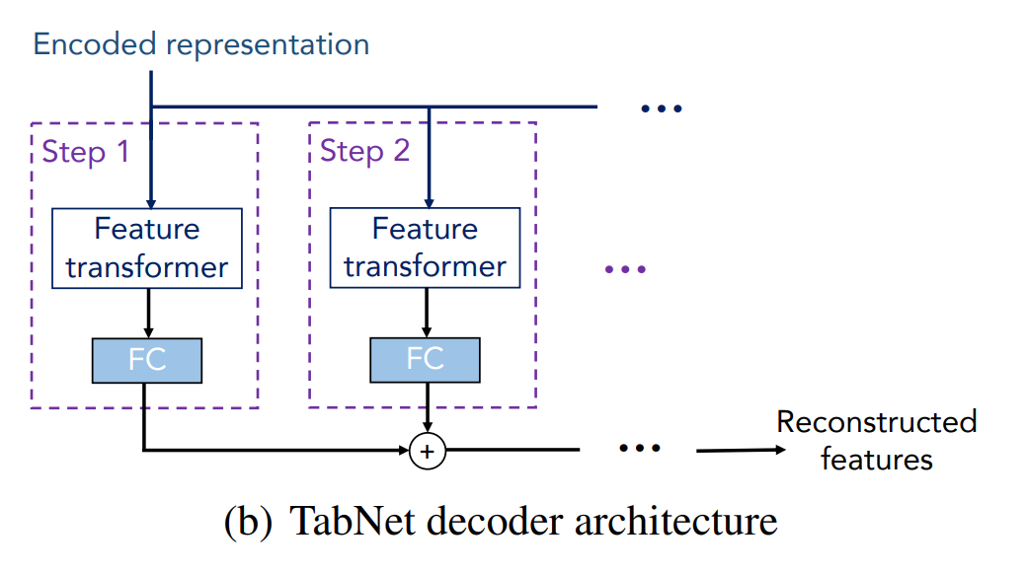
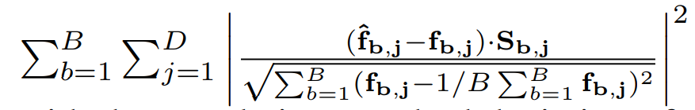
Architecture
Self-Supervised Pretrain
Loss:

Slide 14
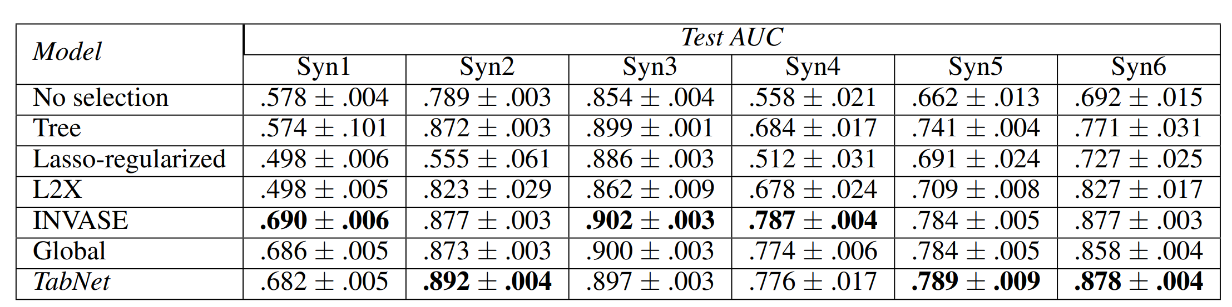
Experiments
Instance-wise feature selection
Synthetic datasets constructed in such a way that only a subset of the features determine the output
For Syn1- Syn3, salient features are same for all instances(e.g.,output of Syn2 depends on features X3-X6)
For Syn4-Syn6, salient features are instance dependent(e.g., for Syn4, the output depends on either X1-X2 or X3-X6 depending on the value of X11)

Slide 15
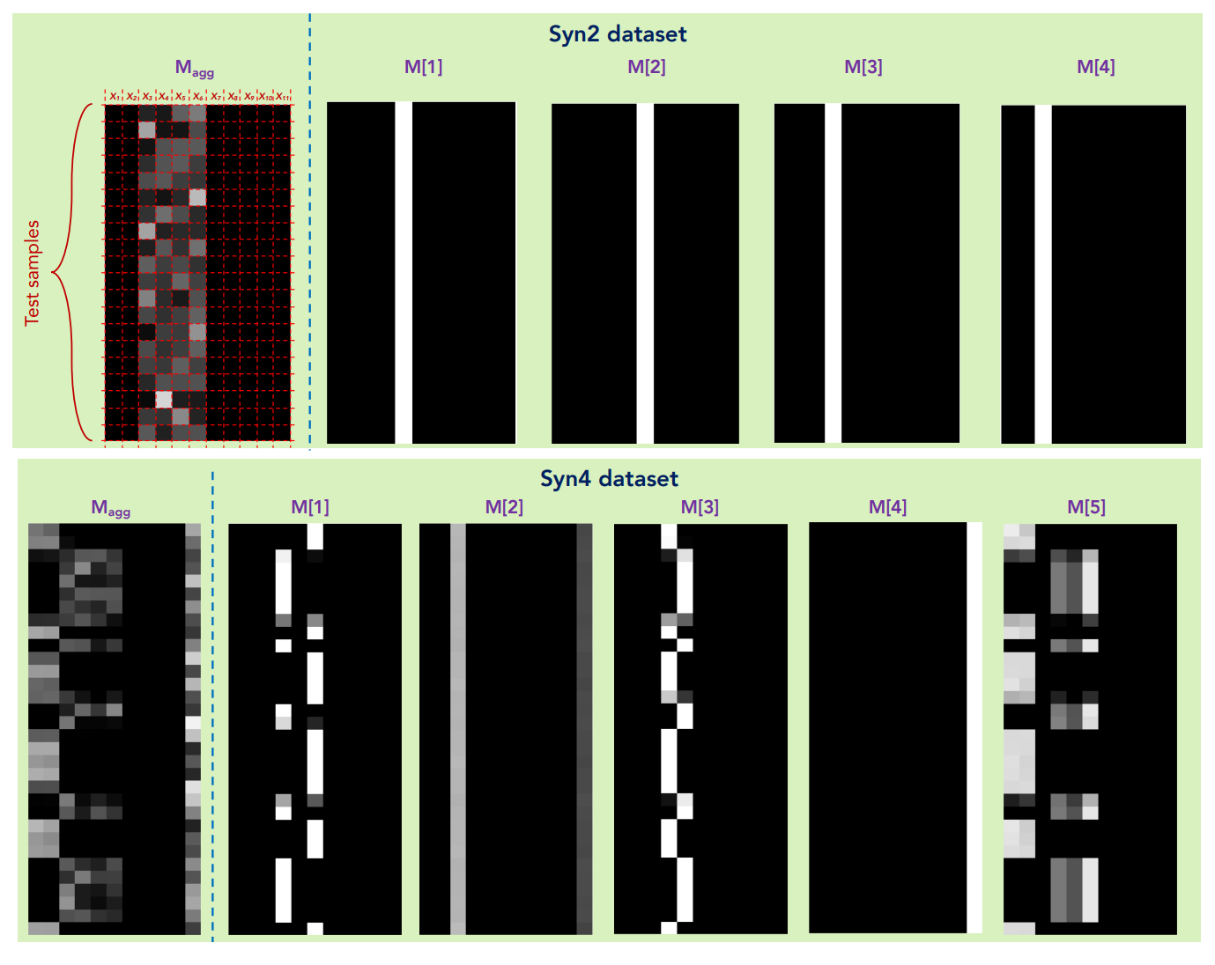
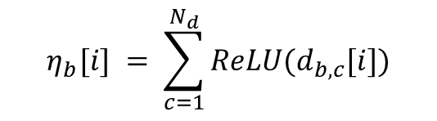
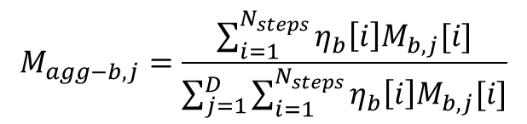
Experiments
Instance-wise feature selection
$$η_{b}[i] = \sum_{c=1}^{N_{d}}{ReLU(d_{b,c}[i])}$$
$$M_{agg−b,j}=\frac{\sum_{i=1}^{N_{steps}}{η_{b}\left[i\right]M_{b,j}[i]}}{\sum_{j=1}^{D}{\sum_{i=1}^{N_{steps}}{η_{b}\left[i\right]M_{b,j}[i]}}}$$

Slide 16
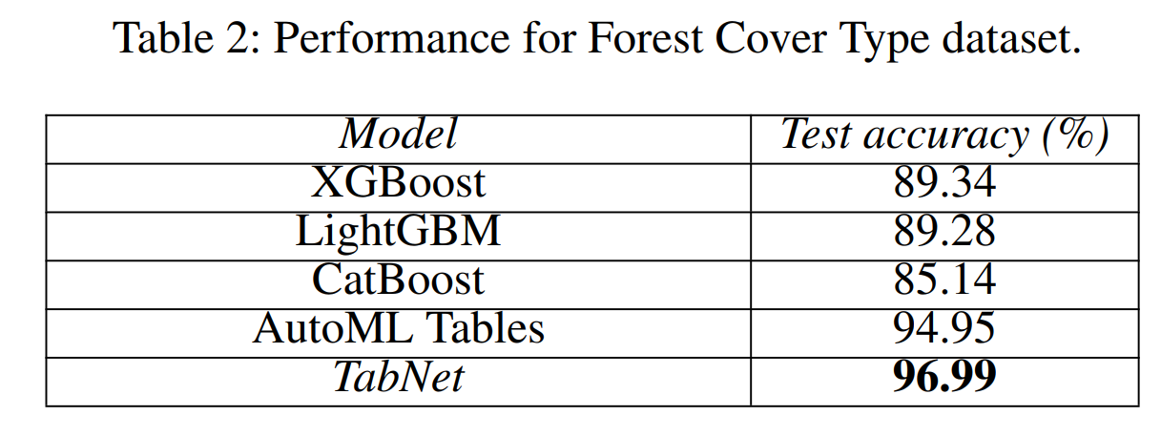

Experiments
Performance on real-world datasets

Slide 17
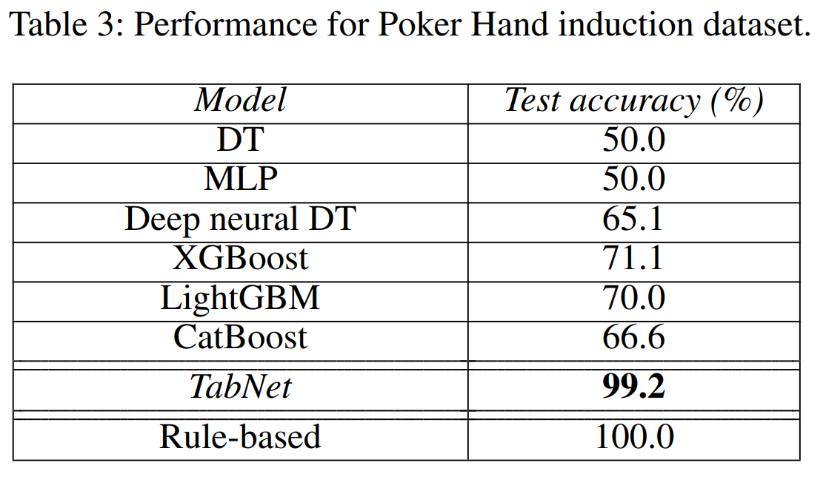
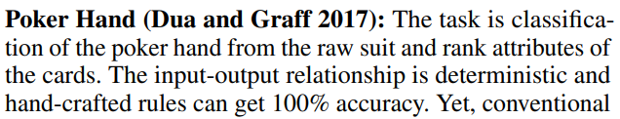
Experiments
Performance on real-world datasets

Slide 18
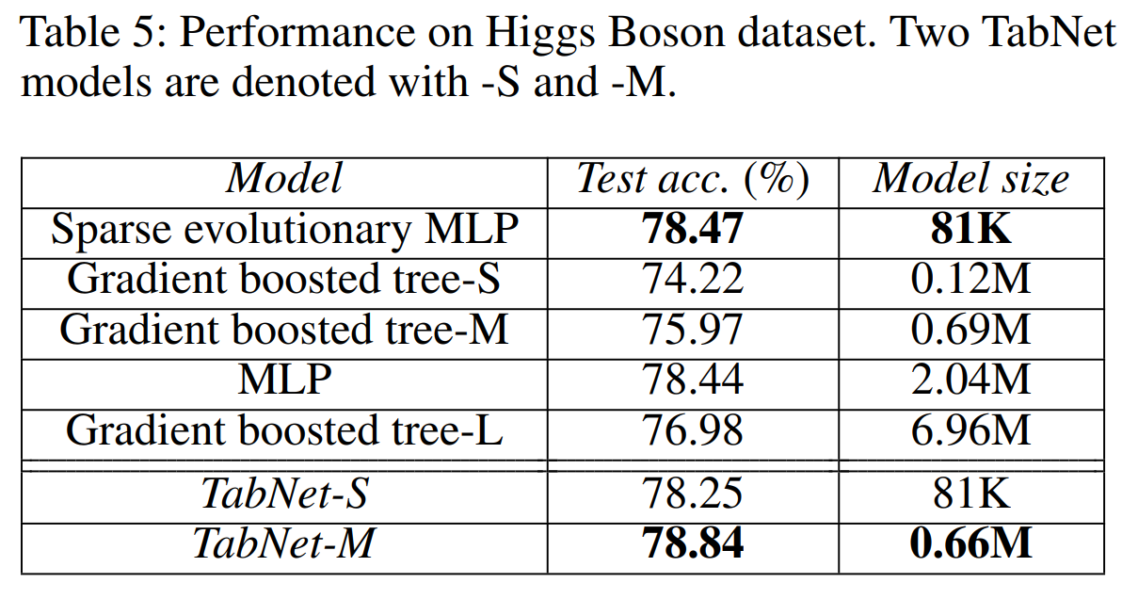
Experiments
Performance on real-world datasets

Slide 19
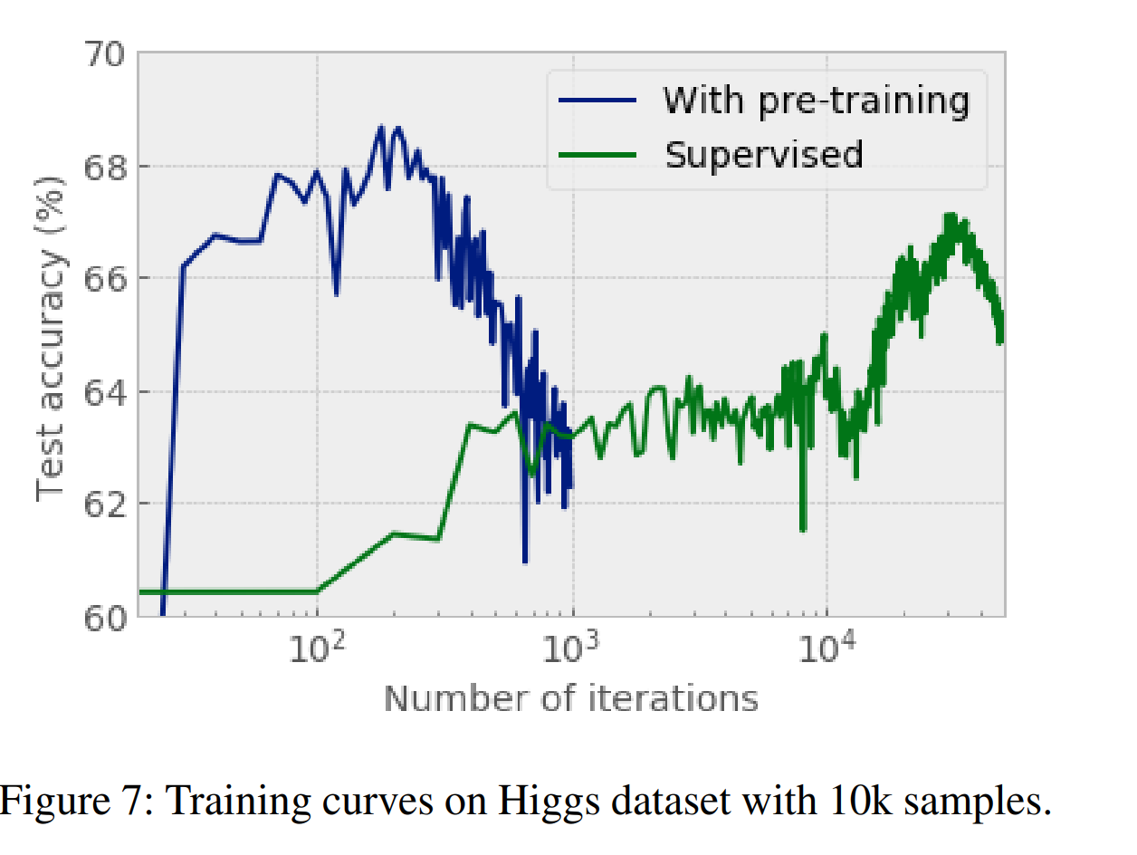
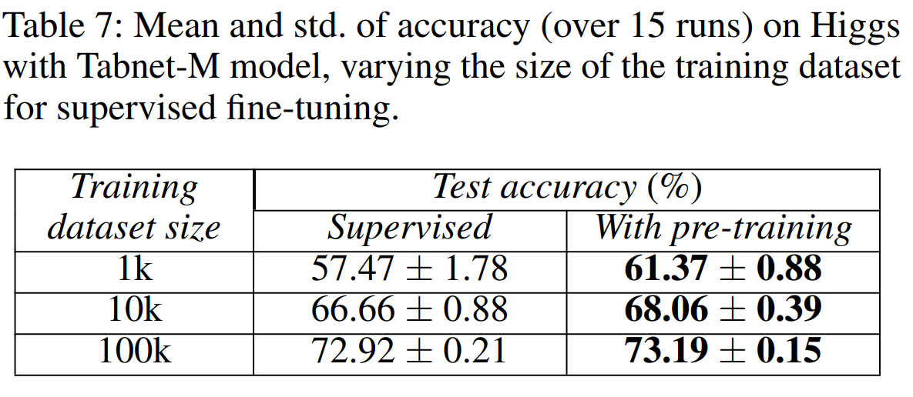
Experiments
Self-supervised learning

Slide 20
Thanks

